Slide 1

Title
Supervisor Research Scholar
Dr. G.Michael T.Hemavathi
Professor 192371089
Saveetha School of Engineering Saveetha School of Engineering
LEXICAL ANALYSER:TO IDENTIFY AND CLASSIFY LEXICAL TOKENS

Slide 2
ABSTRACT
It processes source code into tokens for further analysis.
Tokens include keywords, identifiers, operators, and literals.
It uses regular expressions and finite automata for token recognition.
A lexical analyzer is the first phase of a compiler.
Efficient lexical analysis improves compiler performance and accuracy.
It removes whitespace, comments, and unnecessary characters from the code.
The lexical analyzer detects and reports lexical errors in the source code.
It interacts with the symbol table to store identifiers and their attributes.
Lexical analyzers are implemented using tools like Lex, Flex, and ANTLR.
This phase ensures that the parser receives a clean and structured input.

Slide 3
Introduction
The lexical analyzer is responsible for reading the source code sequentially.
It groups characters into meaningful sequences called tokens.
Tokens represent different elements like keywords, literals, and symbols.
This process simplifies the work of the syntax analyzer (parser).
The lexical analyzer ignores whitespace, comments, and delimiters.
It ensures that the input program follows the lexical rules of the language.
Errors like invalid characters and unrecognized symbols are detected here.
It plays a crucial role in converting high-level code into machine-processable form.
Lexical analyzers are implemented using tools like Lex and Flex.
This phase makes compilation faster and more structured.
The lexical analyzer uses pattern matching techniques to identify tokens.
It helps in making the compilation process efficient and error-free.
Without lexical analysis, the compiler would struggle to interpret raw source code.
It acts as a bridge between the source code and the syntax analyzer.
A well-designed lexical analyzer improves the overall performance of a compiler.

Slide 4
Importance of Lexical Analyser
The Lexical Analyzer identifies and classifies lexical tokens like keywords, identifiers, and operators.
It converts raw code into structured tokens, simplifying syntax analysis and code interpretation.
Early detection of invalid tokens improves error handling and debugging.
It optimizes performance by filtering out unnecessary elements like spaces and comments.
Lexical analysis is widely used in compilers, interpreters, text processing, and NLP applications.
Its efficiency ensures accurate and streamlined language processing.

Slide 5
Overview of Lexical Analyser
Tokenization Process
A Lexical Analyzer scans source code and converts it into meaningful tokens.
These tokens include keywords, identifiers, operators, literals, and special symbols.
Code Optimization
It removes unnecessary elements like whitespace and comments to improve efficiency.
Error Detection & Debugging
Early detection of invalid tokens enhances error handling and debugging.
Applications
It plays a key role in compilers, interpreters, text processing, and NLP applications.
Importance in Compilation
As the first phase of compilation, it ensures structured and optimized code execution.
Performance Enhancement
The lexical analyzer speeds up the compilation process by structuring raw code efficiently.
It reduces processing time for the syntax and semantic analysis phases.
Versatility in Computing
Used in programming language compilers, query processors, and scripting engines.

Slide 6
Existing models in Lexical Analyser
Lex (Lexical Analyzer Generator)
A popular tool for generating lexical analyzers.
Used in conjunction with Yacc (Yet Another Compiler Compiler) for syntax analysis.
Converts regular expressions into C code for token recognition.
Ragel (State Machine Compiler)
Combines lexical analysis and finite state machines.
Generates code in C, C++, Java, and Ruby, making it versatile.
Suitable for embedded systems and protocol parsing.
PLY (Python Lex-Yacc)
A Python-based implementation of Lex & Yacc.
Useful for creating interpreters, compilers, and language parsers in Python.
Provides flexibility and ease of integration with Python projects.

Slide 7
Limitations of "Lexical Analyzer: To Identify and Classify Lexical Tokens"
Inability to Understand Syntax & Semantics
It relies on later stages like parsing and semantic analysis for deeper understanding.
Difficulty Handling Context-Sensitive Tokens
Some programming languages have context-sensitive keywords (e.g., "goto" vs. variable name), which lexical analyzers cannot distinguish on their own.
A lexical analyzer only breaks down code into tokens but cannot detect syntax or semantic errors.
Context-aware analysis requires additional processing beyond lexical analysis.

Slide 8
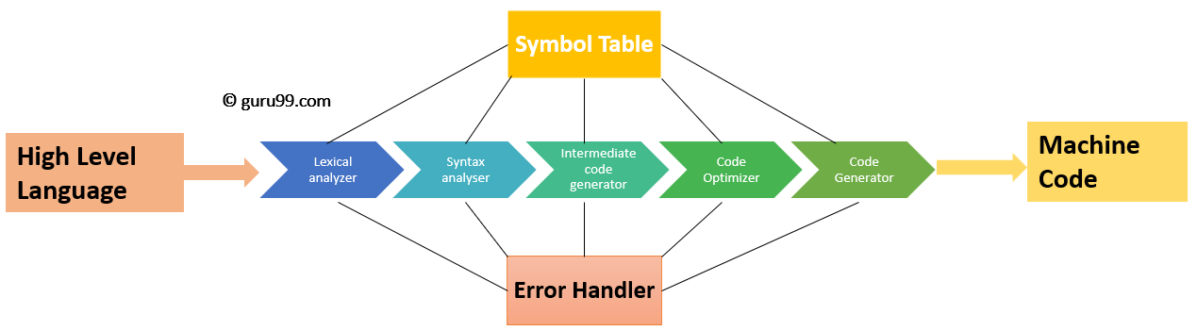
Flowchart for the Lexical Analyser

Slide 9
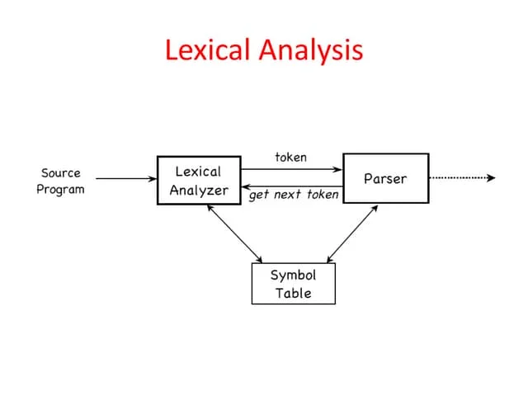
Implementation of Lexical Analysis

Slide 10
Future Enhancement of Lexical Analyser
Context-Aware Tokenization
Implement advanced machine learning or AI-based techniques to improve token classification.
Enable recognition of context-sensitive keywords for better accuracy Enhanced Error Recovery Mechanisms
Develop self-correcting algorithms to handle lexical errors more efficiently.
Provide detailed suggestions instead of just flagging errors
Multi-Language Support
Extend the lexical analyzer to support multiple programming languages.
Implement adaptive tokenization based on language-specific rules.

Slide 11
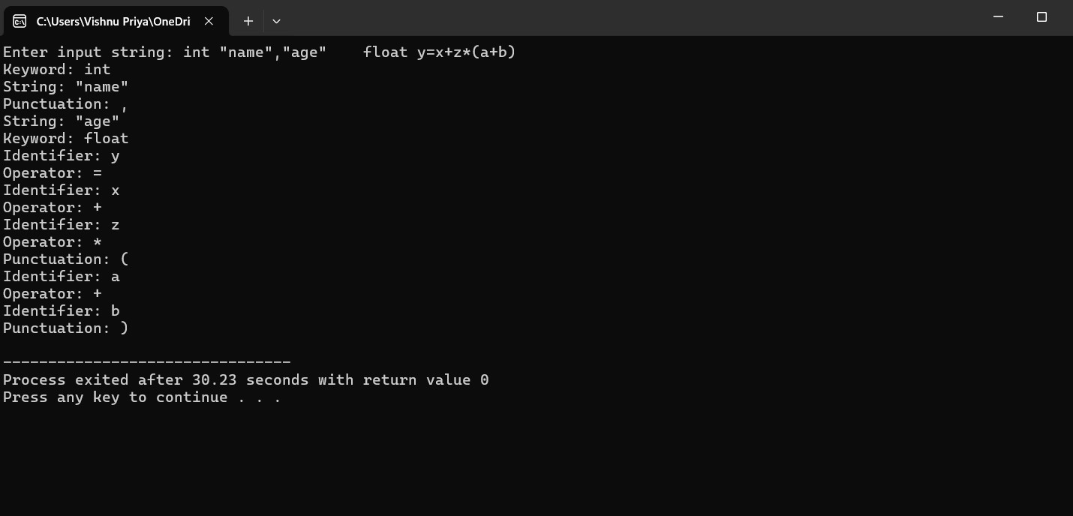
Output

Slide 12
Conclusion
The Lexical Analyzer identifies and classifies tokens like keywords, identifiers, and operators.
It simplifies syntax and semantic analysis by converting raw source code into structured tokens.
This improves code readability, debugging, and overall program efficiency.
However, it has limitations, such as lack of syntax understanding and handling context-sensitive tokens.
Future enhancements, like AI integration and cloud-based processing, can improve its performance.
Despite its challenges, the lexical analyzer remains crucial for compiler design and text processing applications.
Its continued development will lead to more efficient, intelligent, and versatile language processing systems.
As programming languages evolve, lexical analyzers will adapt to support modern coding paradigms and optimization techniques.

Slide 13
References
Aho, A. V., Lam, M. S., Sethi, R., & Ullman, J. D. (2006). Compilers: Principles, Techniques, and Tools. Addison- Wesley.
t, S., & Deroy, A. (2024). Generative AI and Its Impact on Personalized Intelligent Tutoring Systems. arXiv preprint arXiv:2410.10650.
St-Hilaire, F., Vu, D. D., Frau, A., Burns, N., Faraji, F., Potochny, J., ... & Serban, I. V. (2022). A New Era: Intelligent Tutoring Systems Will Transform Online Learning for Millions. arXiv preprint arXiv:2203.03724.
St-Hilaire, F., Vu, D. D., Frau, A., Burns, N., Faraji, F., Potochny, J., ... & Serban, I. V. (2022). A New Era: Intelligent Tutoring Systems Will Transform Online Learning for Millions. arXiv preprint arXiv:2203.03724.

Slide 14


